Slide 1
R in Animal Crossing
Use Line Chart, Box Plot, and Histogram & Density Plot to show the price trend of turnips in Animal Crossing and determine the selling point.
4/15/2020
Jinhan Huang, Ailin Zhang, Keren Zhang

Slide 2
Contents
Background
Abstract
Introduction
Materials & Methods
Results
Discussion
Acknowledgements
Literature Cited
Improvement

Slide 3

Background
Animal Crossing is one of the most popular new video games recently. The game is about living on an uninhabited island. Players can build their own kingdoms using imaginations.

Slide 4
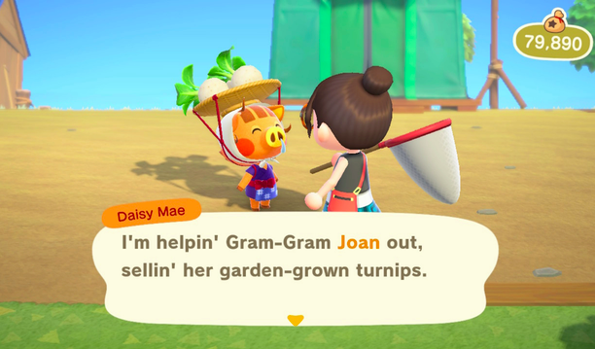
Background
In order to earn enough money to construct new facilities, player need to make money. One of the best way is to buy turnips and sell with a better price to earn profits, which is similar to stocks.

Slide 5
Abstract
Our project used graphs such as Density plot and Histogram, Box plot, and Line chart to observe the fluctuations in price of turnips during a week and analyze the four patterns of its fluctuations. Our goal is to find the distribution of the turnips’ price and determine the best time to sell the Turnips.

Slide 6
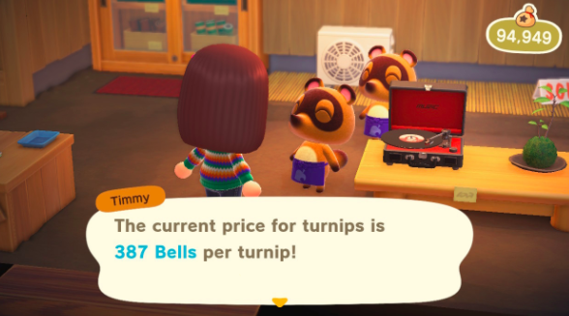
Introduction
Every Sunday morning Daisy will come to your island and sell turnips. For the rest of the week, you can sell the turnips in the store on your island or others’ islands. The price will change once everyday at noon. However, if you don’t sell your turnips before Sunday, all the turnips will be rotted, and you will lose all the cost.

Slide 7
Materials & Methods
We have collected the price trend for 15 players who monitored the market price of turnips from their stores last week.
In the following few slides, we will show you the data we collected, and the methods we used to analysis.

Slide 8
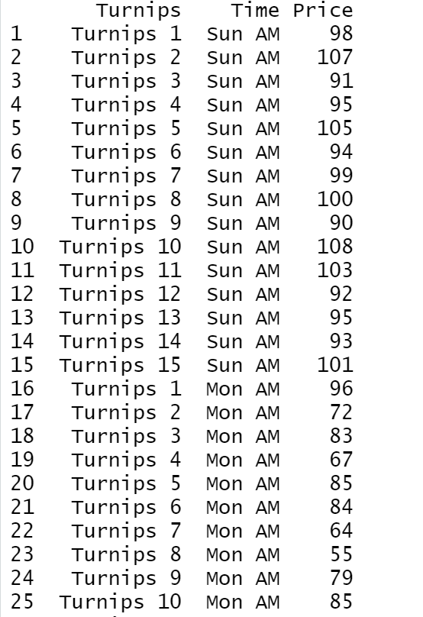
Materials & Data
Turnips Daily Prices example (Shown in attached Excel file) :

Slide 9
Methods
Price in our case is the variable we observed.
Line chart is being used to show different prices in different players’ store.
Density plot and histogram are being used in the analysing process since they can show the probability of getting a better price.
Box plot is being used for displaying the distribution of prices at different times and for analysing.

Slide 10
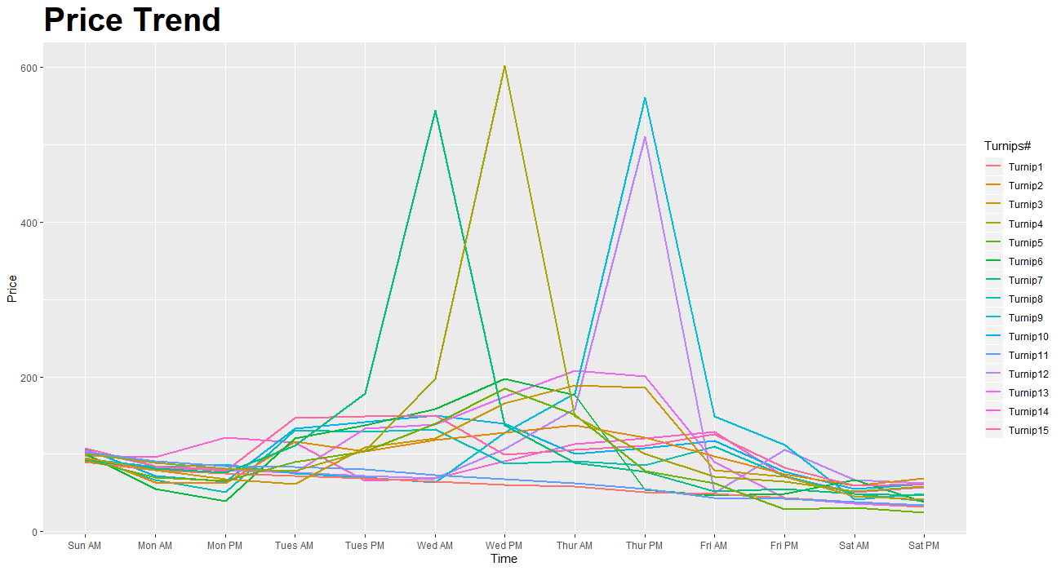
1. Line chart

Slide 11
Results
After the analysis, we found that there are four patterns to show the trend of turnips: Fluctuating, Large Spike, Small Spike, and Decreasing.
From the Line Chart, we can see that the price of Turnip 1, Turnip 2, Turnip 4, Turnip 7, and Turnip 10 belong to Fluctuating Trend. Their prices fluctuate up and down within the week and the peak value can reach 1.2 to 1.5 times of the buy-in price.

Slide 12
Results
Then, for Turnip 3, Turnip 6, Turnip 12, & Turnip 15, they belong to Large Spike Type. The price fell slightly in the previous period, and began to rise on Tuesday and Wednesday. It rose slightly for three consecutive times and reached its peak in the third time. The peak value can reach 2-6 times the purchase price.

Slide 13
Results
For Turnip 5, Turnip 8, Turnip 13, & Turnip 14, they are Small Spike Type. The price fell slightly in the previous period, and began to rise on Tuesday and Wednesday. It rose slightly for four consecutive times and reached its peak in the fourth time. The peak value can reach 2-3 times the purchase price.
Lastly, Turnip 9 & Turnip 11 are Decreasing Trend. Its price continuous decreasing within the week.

Slide 14
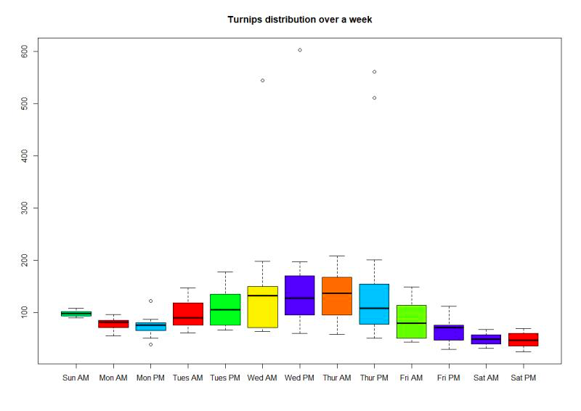
2. Box Plot

Slide 15
Results
From the Box Plot, the medians of market price from Wednesday AM to Thursday PM are higher than any other time. Also, outliers that well above the normal market price appeared during the same period.
From the Box Plot, we also found that the market price after Thursday PM are showing in a decreasing trend. The probability to get a good selling price will be much lower from Thursday PM.

Slide 16
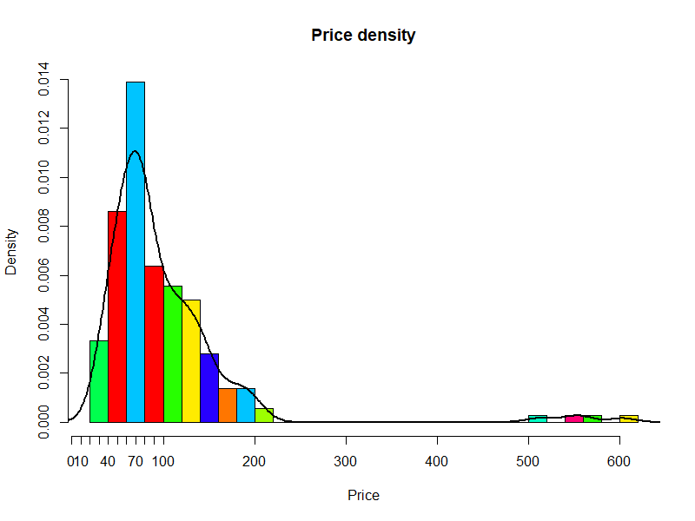
3. Histogram & Density Plot

Slide 17
Results
From the plot, we can see that the graph is right-skewed. It is a positive skewed. With the right-skewed graph, the mean always comes to the right of the mode.
We can see that as the prices go higher, the probability of getting high prices become very small and the appearance is very random.

Slide 18
Discussion
After all analysis ,we conclude that:
There are four different trends in the price market, which directly determined different best selling points. They are as follow:
Decreasing Trend: As its name implies, the price are expected to continue falling. Sell them as soon as possible.
Large Spike Type: The large spike type price trend have three rising points and the third one will create the peak. Sell the turnips at the third peak point.
Small Spike Type: The small spike type price trend have four rising points and the fourth one will create the peak. Don’t be hesitate to sell it at the fourth peak point.
Fluctuating Trend: The buy-in price was not high. The price will fluctuates slightly but not plunge suddenly during the week. You can sell turnips at a stable price.

Slide 19
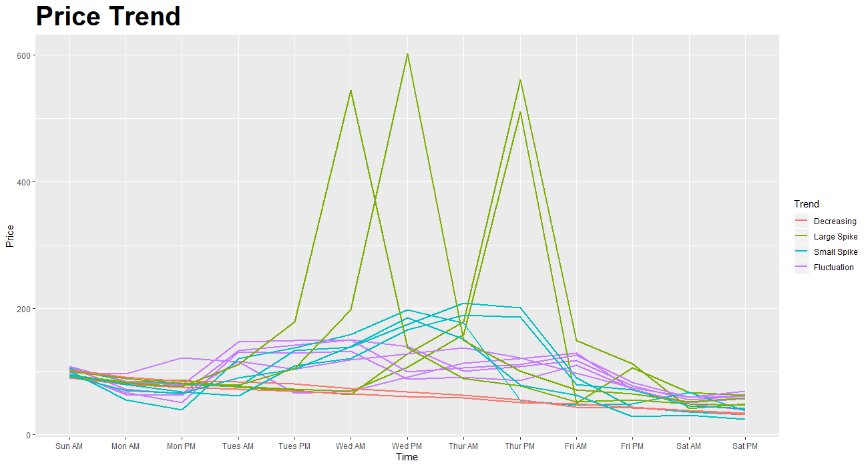
Classified Graph

Slide 20
Discussion
No matter which price trend your turnips have, selling turnips on Wednesday and Thursday have more chances of getting a highest profit. And do not keep turnips until Friday.

Slide 21
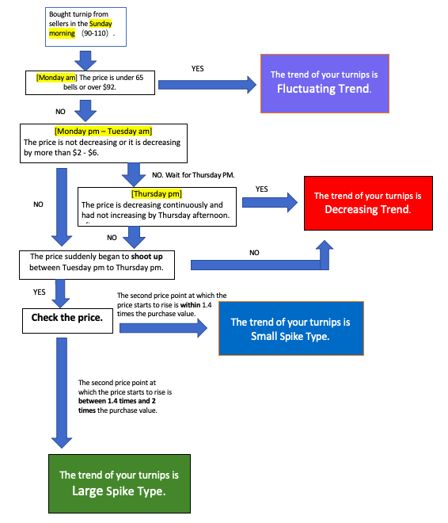
Improvement
To improve our research, we made a step chart on the left to show how to observe the price trend.

Slide 22
Literature Cited
https://www.gamespot.com/articles/animal-crossing-turnips-guide-how-to-play-new-hori/1100-6475474/
https://turnipprophet.io/index.html
https://www.cnn.com/2020/04/24/culture/elijah-wood-animal-crossing-trnd/index.html

